Slide 1
Mathematicians

Slide 2
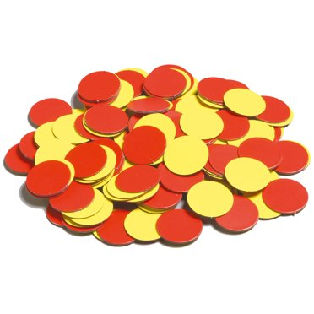
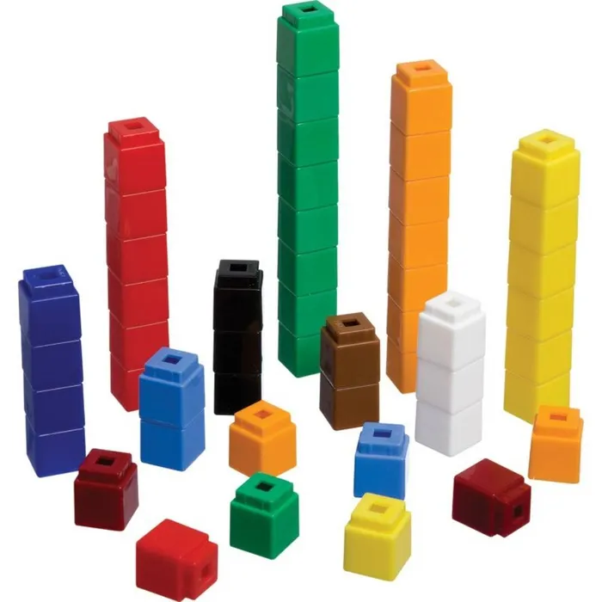
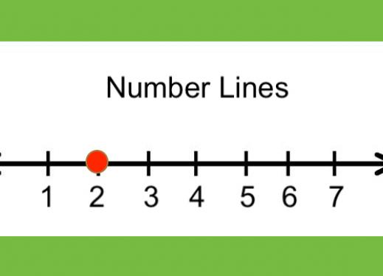
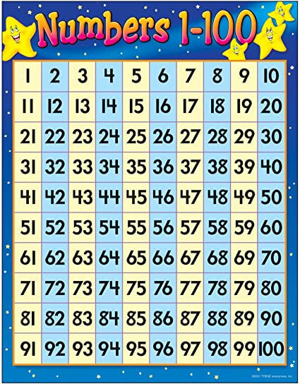
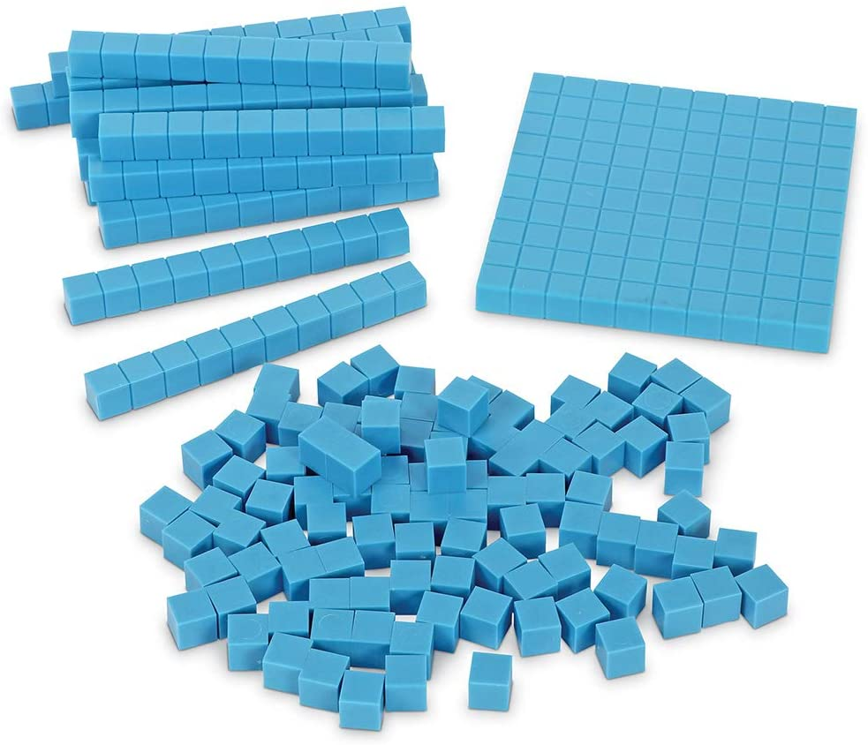

Math Tools

Slide 3
Learning Target:
I can pick the right tools to represent 3 digit numbers in different ways.
Success Criteria:
I used tools (blocks, pictures, numbers, and more!) to represent 3 digit numbers.

Slide 4
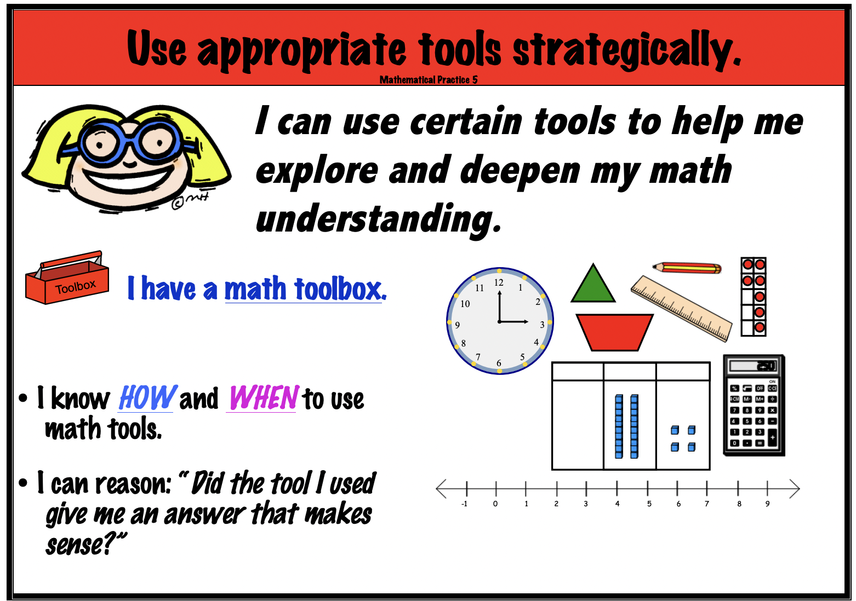
Mathematicians use math practices!

Slide 5

What tools can I use to represent this number?

Slide 6
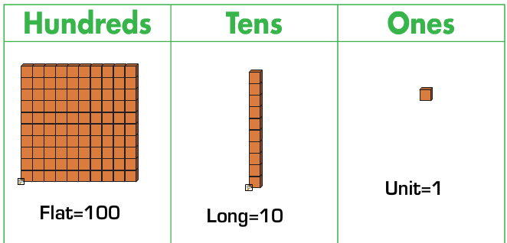

Slide 7
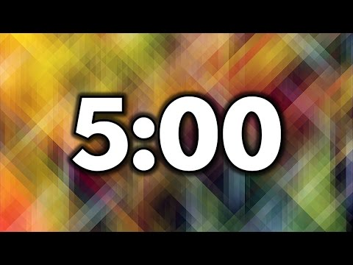
What tools can I use to represent this number?

Slide 8
What did we find?

Slide 9
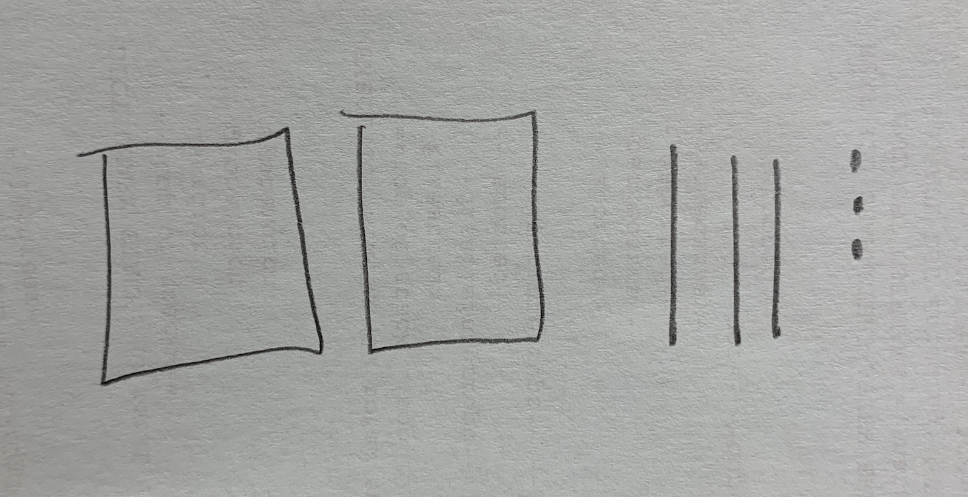
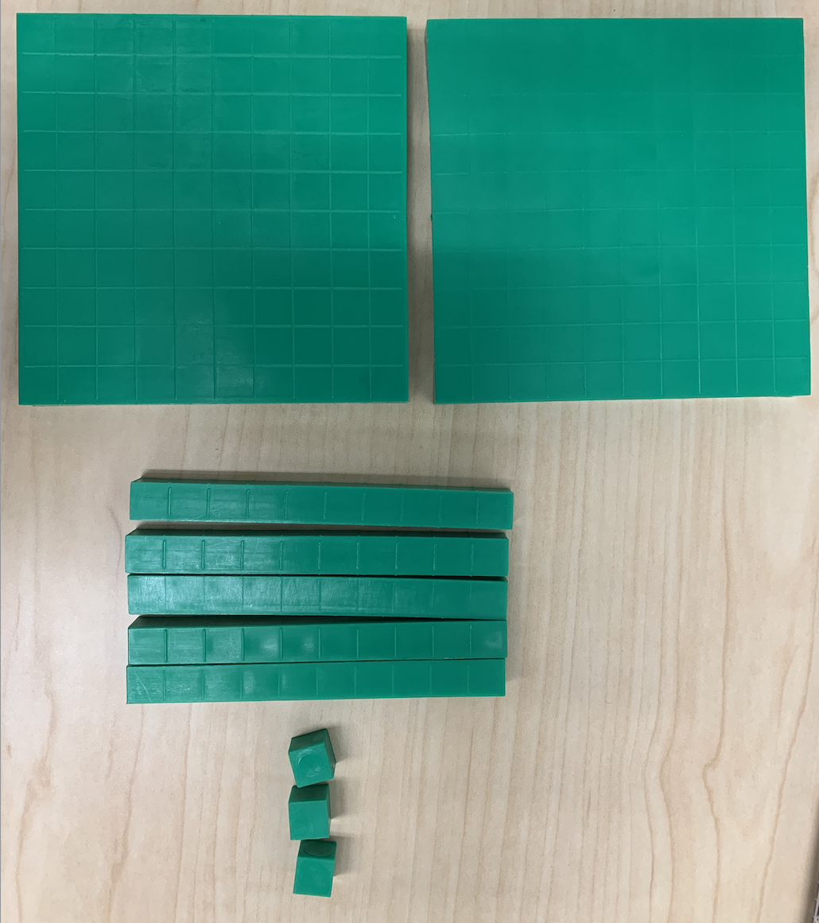
253

Slide 10
Success Criteria:
I used tools (blocks, pictures, numbers, and more!) to represent 3 digit numbers.

