Slide 1
Learning Target
How can I work together to find a solution to a problem?
Success Criteria
I worked together with my classmates to make sense of a problem and persevere in solving it.
Notes:
Have students guess why certain words are in color text and bold. Ask them to explain what those bold words mean.

Slide 2
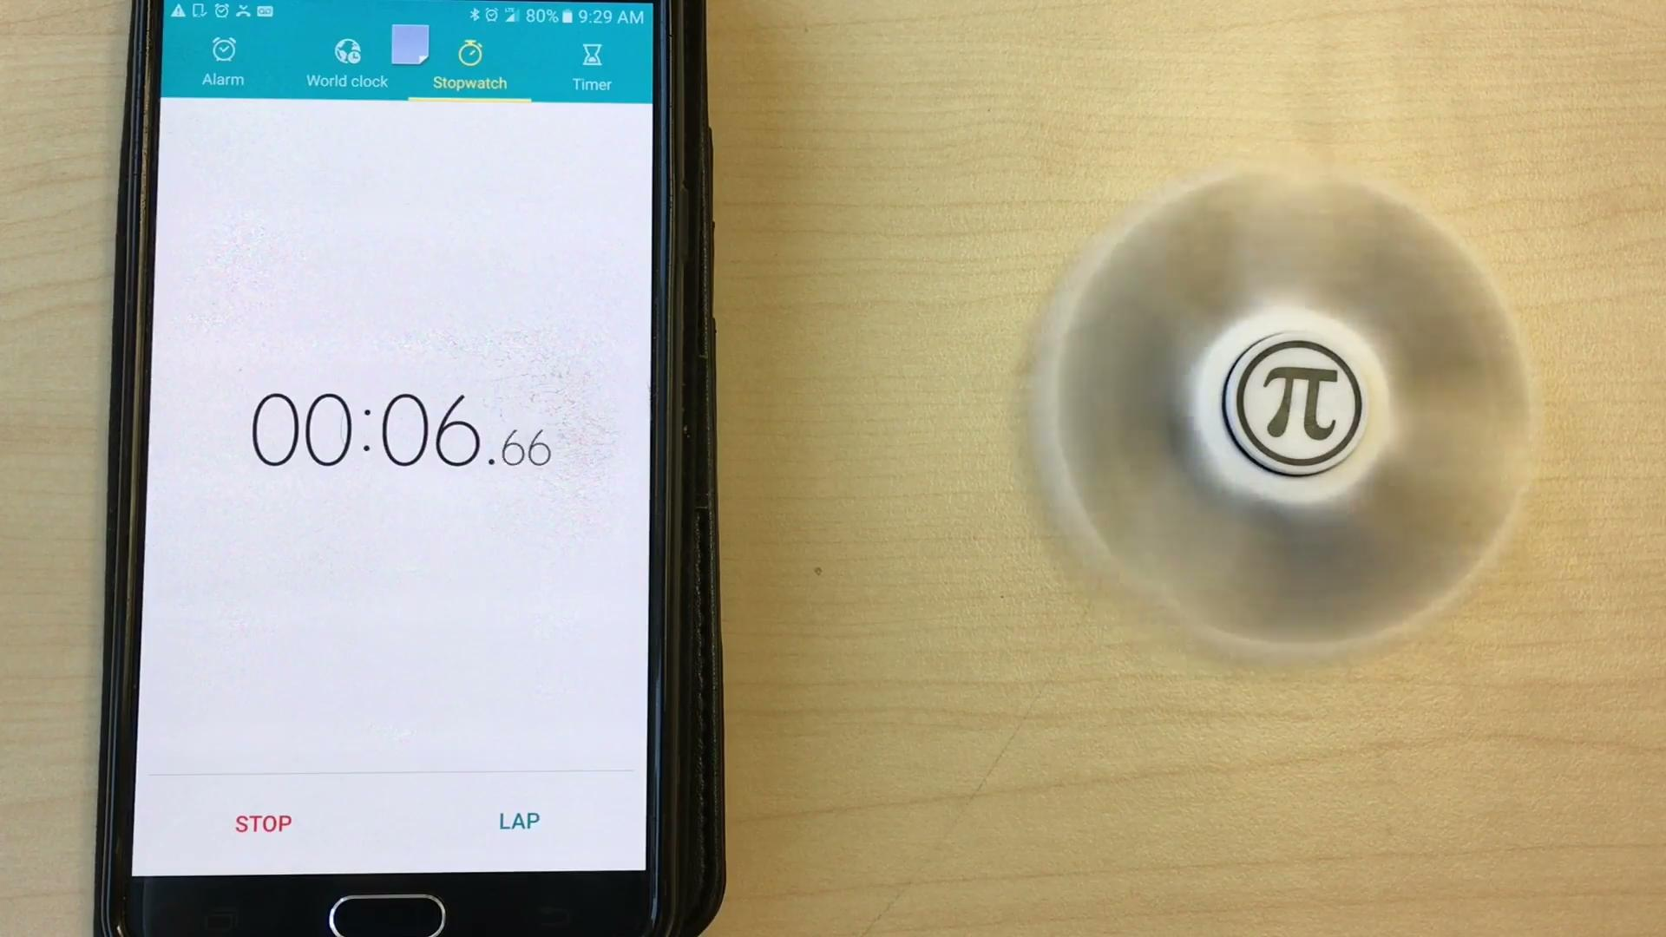
Notes:
What do you wonder?
Main question: How long will the Fidget Spinner spin?
Estimate. Too high? Too low?

Slide 3
How long will the fidget spinner spin?
Let’s make an estimate.
What is an estimate you think will be too high?
What is an estimate you think will be too low?

Slide 4
How long will the fidget spinner spin?
What information will need to figure this out?

Slide 5
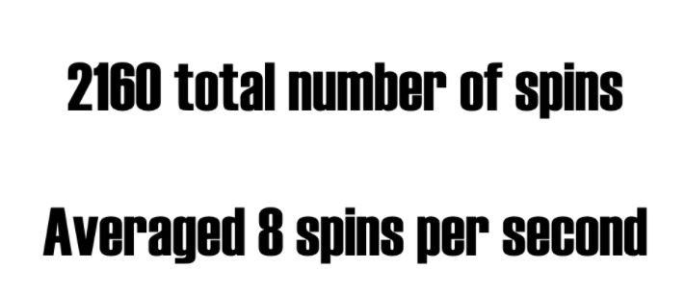

Slide 6
Discuss with your group:
“How can we use this information to figure out how long the spinner will spin”?

Slide 7
With your group:
Discuss together how you will go about solving this problem.
What information do you need to make sense of this problem? Do you have all the information you need?
Be ready to prove your solution to others. How will your group do that?

Slide 8
As Groups are presenting...
Your job is to:
Listen
Ask them questions to extend your own thinking
Ask them questions if you don’t understand something
Share how their thinking relates to yours

Slide 9
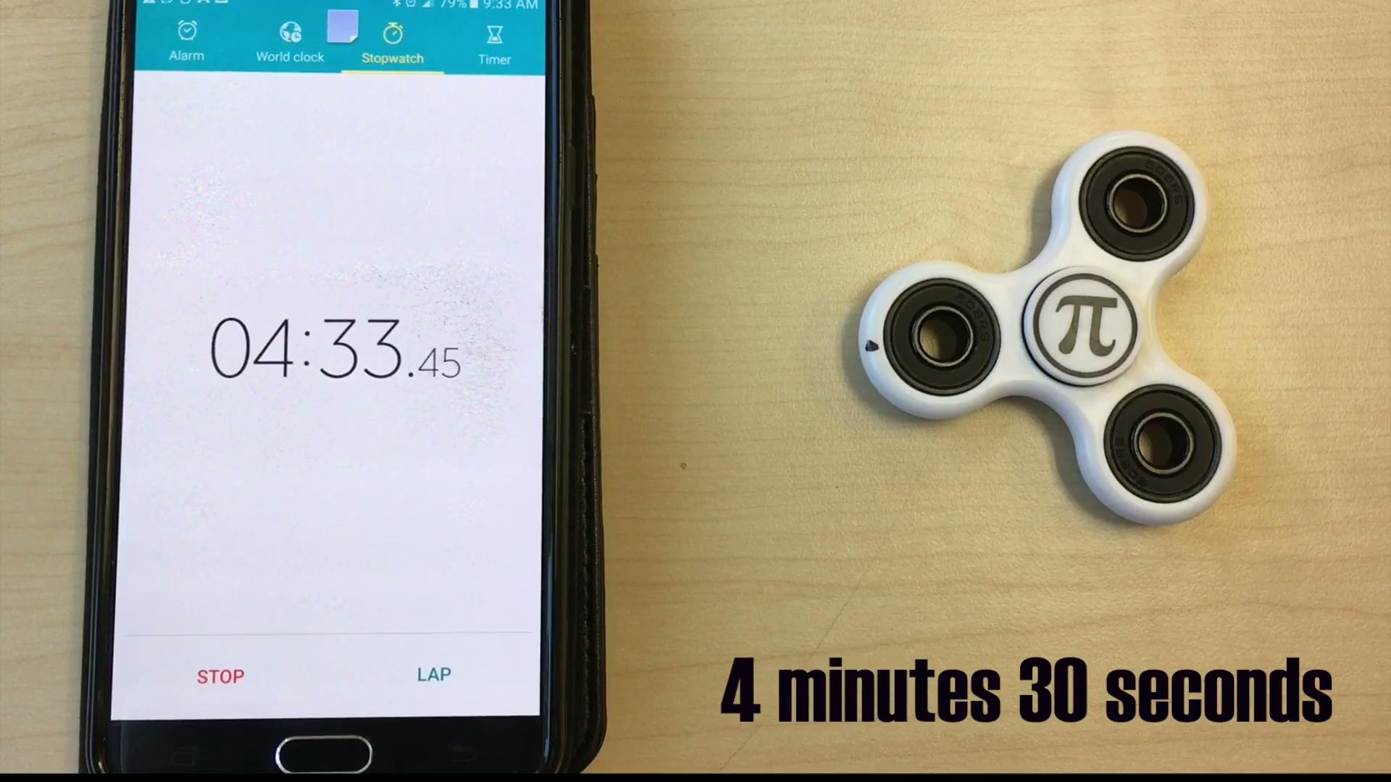

Slide 10
Learning Target
How can I work together to find a solution to a problem?
Success Criteria
I worked together with my classmates to make sense of a problem and persevere in solving it.
Notes:
Did we work together?
What did we find out what we needed to know so the problem made sense?
Did we persevere to find a solution?

