Slide 1
Geometry
August 19th, 2021

Slide 2
Bell Ringer 8-19-2021
Think about the question: Can your brain grow?
Come up with 2-4 reasons why you think your brain can or can not grow.

Slide 3
Think, Pair, Share
Think about the question: Can your brain grow?
Come up with 2-4 reasons why you think your brain can or can not grow.

Slide 4
Video on Brain Growth

Slide 5
What are your Thoughts and/or Questions?

Slide 6
What you have believed about your own potential has changed what you have learned and it continues to do that.

Slide 7
If you believe in your unlimited potential, you will achieve at higher levels in math and in life.

Slide 8
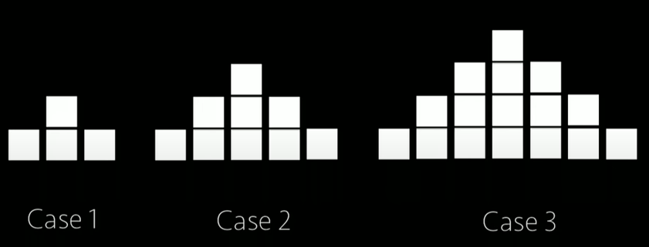
How do you see the shapes growing?

Slide 9
How do you see the shapes growing?

Slide 10
How do you see the pictures growing?

Slide 11


Slide 12
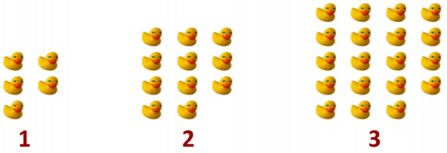

Slide 13
