Slide 1
Distance Formula Mistakes

Slide 2
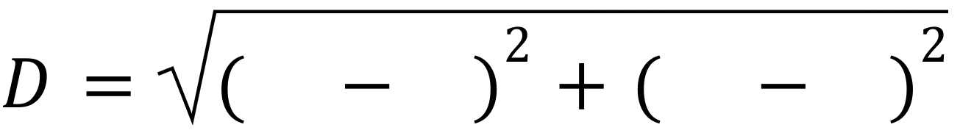
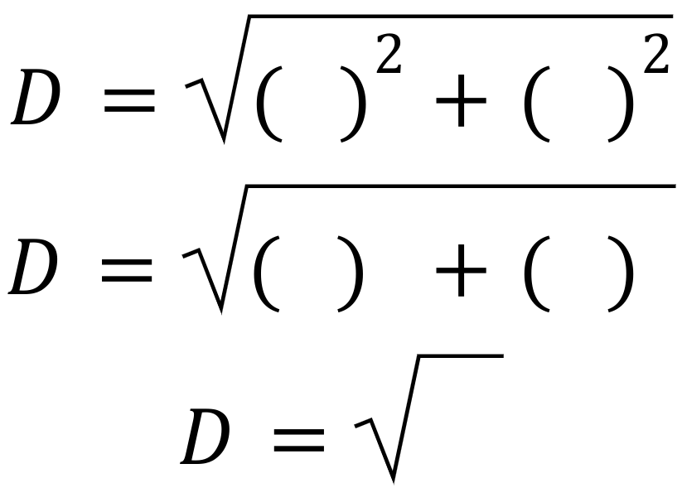
Find the Distance Between A(1, 3) and B(7, 9)
1
3
7
9
-2
-2
4
4
8

Slide 3
Find the Distance Between A(4, 3) and B(7, 9)
4
7
3
9
-3
-6
-9
36
27

Slide 4
Find the Distance Between A(6, 9) and B(2, -8)
6
2
9
8
4
1
16
1
17

Slide 5
Find the Distance Between A(3, 2) and B(-2, 5)
3
5
2
-2
-2
0
4
0
4

